Slide 1
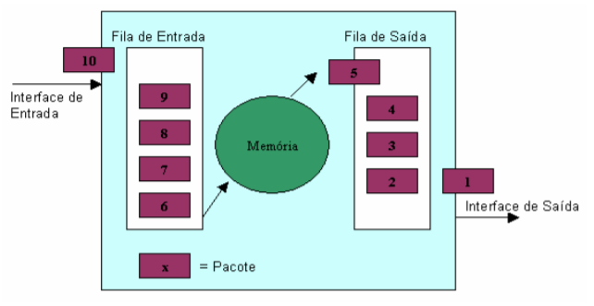
FIRST IN FIRST OUT (FIFO)

Slide 2
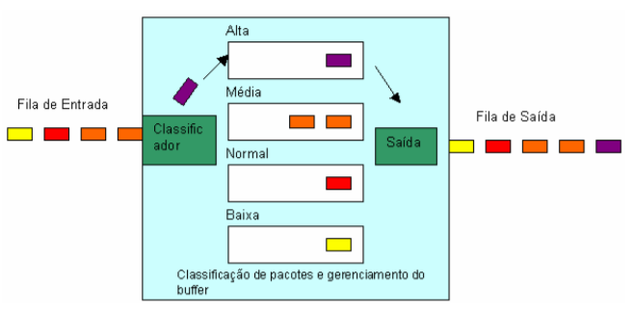
Priority Queuing – PQ

Slide 3
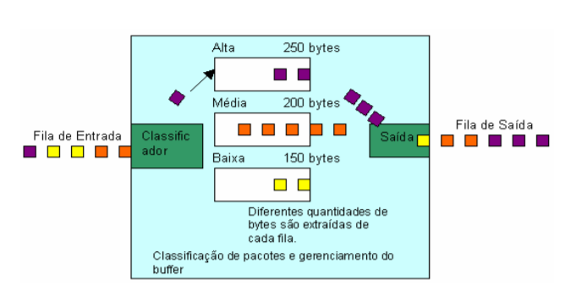
Class Based Queuing – CBQ/Round Robin

Slide 4
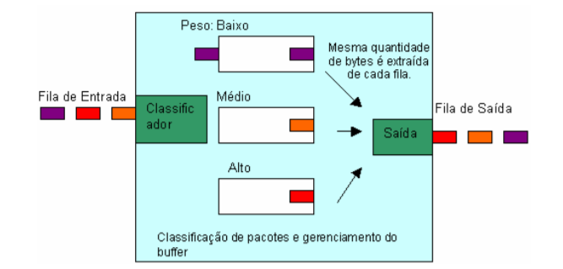
Weighted Fair Queuing –(WFQ)

